Slide 1
MachinE LEarning
Computational Models In Cognitive Science:
Classification Models In Machine Learning

Slide 2
Supervised Learning
Classification

Slide 3
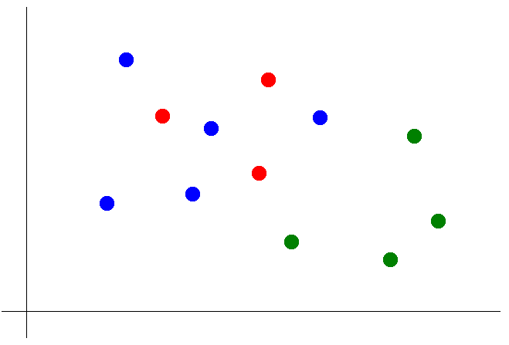
K Nearest Neighbors
Suppose we want to predict the color of the gray dot.
1) Pick a value for k.
2) Find colors of k nearest neighbors.
3) Assign the most common color
to the gray dot.

Slide 4
Logistic Regression for Discrete Outcomes
We want to classify an outcome variable y is either belonging to or not belonging to a particular category.

Slide 5
Multiple Logistic Regression for Discrete Outcomes
y = 1
1 + e^{-z} where z = b₀*1 + b₁*x₁ + … + b_{n}*x_{n} + E

Slide 6
Linear Regression for Continuous Outcomes
p(y|x,θ) = N (y|w^{T}x, σ²)
Data: predictor x’s and outcome y’s
Parameters (θ):
Parameters in this 2-D case are:
w: the weight matrix (consisting of the slope and intercept)
the error function, in this case σ², the sum squared error of all predictions

Slide 7
Linear Regression for Continuous Outcomes
y = mx + b
y = b + mx
y = b0 + b1*x1
y = b0*x0 + b1*x1
y = b0*x0 + b1*x1 + E

Slide 8
Linear Regression for Continuous Outcomes
y = b₀*x₀ + b₁*x₁ + E
y
x₀ x₁
5
7
11
3
7
-1
-7
1 2
1 3
1 5
1 1
1 3
1 -1
1 -4
b0 b1
*
1 2
=
b0 intercept 1
b1 slope 2
Error 0

Slide 9
Linear Regression for Continuous Outcomes
y = b₀*x₀ + b₁*x₁ + E
y
x₀ x₁
5
9
11
2
7
-1
-9
1 2
1 3
1 5
1 1
1 3
1 -1
1 -4
b0 b1
*
0.5134 2.2674
=
b0 intercept 0.5134
b1 slope 2.2674
Error 5.037

Slide 10
Linear Regression for Continuous Outcomes

Slide 11
Multiple Regression for Continuous Outcomes
y = b₀*x₀ + b₁*x₁ + …. + b_{n}*x_{n} + E

Slide 12
Logistic Regression for Discrete Outcomes
We want to classify an outcome variable y is either belonging to or not belonging to a particular category.

Slide 13
Multiple Logistic Regression for Discrete Outcomes
y = b₀*1 + b₁ * 1 + … +b_{n} * 1 + E
1 + e^{-x1/Θ} 1 + e^{-xn/Θ}

